Slide 1
Structure from Motion
03/06/12
Computer Vision
CS 543 / ECE 549
University of Illinois
Derek Hoiem
Many slides adapted from Lana Lazebnik, Silvio Saverese, Steve Seitz, Martial Hebert

Slide 2
This class: structure from motion
Recap of epipolar geometry
Depth from two views
Projective structure from motion
Affine structure from motion

Slide 3
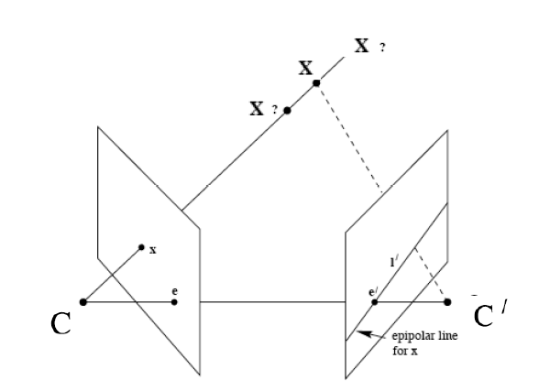
Recap: Epipoles
Point x in left image corresponds to epipolar line l’ in right image
Epipolar line passes through the epipole (the intersection of the cameras’ baseline with the image plane

Slide 4



Recap: Fundamental Matrix
Fundamental matrix maps from a point in one image to a line in the other
If x and x’ correspond to the same 3d point X:

Slide 5
Recap: Automatic Estimation of F
Assume we have matched points x x’ with outliers
8-Point Algorithm for Recovering F
Correspondence Relation
Normalize image coordinates
RANSAC with 8 points
Randomly sample 8 points
Compute F via least squares
Enforce by SVD
Repeat and choose F with most inliers
De-normalize:

Slide 6
Recap
We can get projection matrices P and P’ up to a projective ambiguity (see HZ p. 255-256)
Code:
function P = vgg_P_from_F(F)
[U,S,V] = svd(F);
e = U(:,3);
P = [-vgg_contreps(e)*F e];
See HZ p. 255-256

Slide 7
Recap
Fundamental matrix song

Slide 8
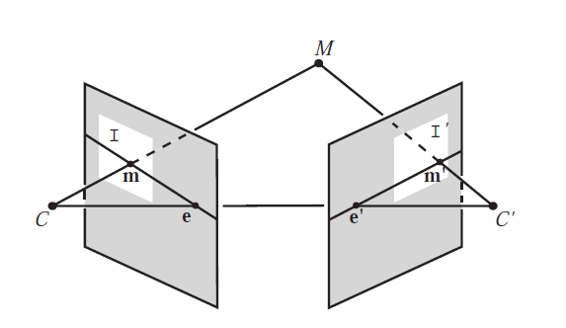
Triangulation: Linear Solution
Generally, rays C→x and C’→x’ will not exactly intersect
Can solve via SVD, finding a least squares solution to a system of equations
X
x
x'
Further reading: HZ p. 312-313

Slide 9
Triangulation: Linear Solution
Given P, P’, x, x’
Precondition points and projection matrices
Create matrix A
[U, S, V] = svd(A)
X = V(:, end)
Pros and Cons
Works for any number of corresponding images
Not projectively invariant
Code: http://www.robots.ox.ac.uk/~vgg/hzbook/code/vgg_multiview/vgg_X_from_xP_lin.m

Slide 10
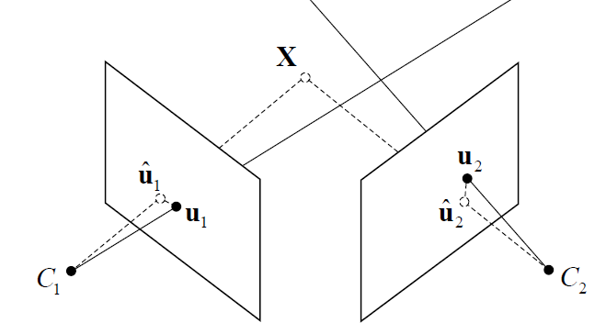
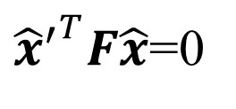




Triangulation: Non-linear Solution
Minimize projected error while satisfying
${{\hat{x}}^{′}}^{T}F\hat{x}$=0
$$cost\left(X\right)=dist{\left(x,\hat{x}\right)}^{2}+dist{\left(x′,\hat{x}′\right)}^{2}$$
$$x′$$
$$\hat{x}$$
$$x$$
$${\hat{x}}^{′}$$
Figure source: Robertson and Cipolla (Chpt 13 of Practical Image Processing and Computer Vision)

Slide 11
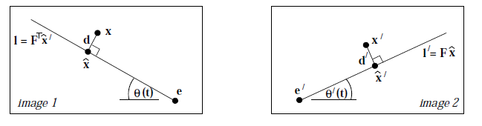

Triangulation: Non-linear Solution
Minimize projected error while satisfying
Solution is a 6-degree polynomial of t, minimizing
${{\hat{x}}^{′}}^{T}F\hat{x}$=0
$$cost\left(X\right)=dist{\left(x,\hat{x}\right)}^{2}+dist{\left(x′,\hat{x}′\right)}^{2}$$
Further reading: HZ p. 318

Slide 12
Projective structure from motion
Given: m images of n fixed 3D points
x_{ij} = P_{i} X_{j} , i = 1,… , m, j = 1, … , n
Problem: estimate m projection matrices P_{i} and n 3D points X_{j} from the mn corresponding 2D points x_{ij}
X_{j}
x_{1j}
x_{3j}
x_{2j}
P₁
P₃
Slides from Lana Lazebnik
P₂

Slide 13
Projective structure from motion
Given: m images of n fixed 3D points
x_{ij} = P_{i} X_{j} , i = 1,… , m, j = 1, … , n
Problem: estimate m projection matrices P_{i} and n 3D points X_{j} from the mn corresponding points x_{ij}
With no calibration info, cameras and points can only be recovered up to a 4x4 projective transformation Q:
X → QX, P → PQ⁻¹
We can solve for structure and motion when
2mn >= 11m +3n – 15
For two cameras, at least 7 points are needed

Slide 14
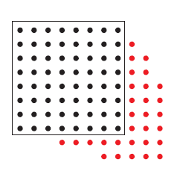
Sequential structure from motion
Initialize motion from two images using fundamental matrix
Initialize structure by triangulation
For each additional view:
Determine projection matrix of new camera using all the known 3D points that are visible in its image – calibration
points
cameras

Slide 15
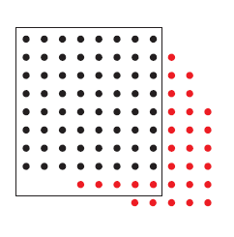
Sequential structure from motion
Initialize motion from two images using fundamental matrix
Initialize structure by triangulation
For each additional view:
Determine projection matrix of new camera using all the known 3D points that are visible in its image – calibration
Refine and extend structure: compute new 3D points, re-optimize existing points that are also seen by this camera – triangulation
points
cameras

Slide 16
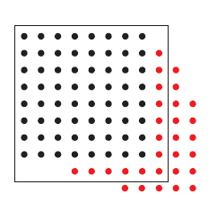
Sequential structure from motion
Initialize motion from two images using fundamental matrix
Initialize structure by triangulation
For each additional view:
Determine projection matrix of new camera using all the known 3D points that are visible in its image – calibration
Refine and extend structure: compute new 3D points, re-optimize existing points that are also seen by this camera – triangulation
Refine structure and motion: bundle adjustment
points
cameras

Slide 17
Bundle adjustment
Non-linear method for refining structure and motion
Minimizing reprojection error
X_{j}
P₁X_{j}
x_{1j}
x_{3j}
P₃X_{j}
P₂X_{j}
x_{2j}
P₁
P₃
P₂

Slide 18
Auto-calibration
Auto-calibration: determining intrinsic camera parameters directly from uncalibrated images
For example, we can use the constraint that a moving camera has a fixed intrinsic matrix
Compute initial projective reconstruction and find 3D projective transformation matrix Q such that all camera matrices are in the form P_{i} = K [R_{i} | t_{i}]
Can use constraints on the form of the calibration matrix, such as zero skew

Slide 19
Summary so far
From two images, we can:
Recover fundamental matrix F
Recover canonical cameras P and P’ from F
Estimate 3D positions (if K is known) that correspond to each pixel
For a moving camera, we can:
Initialize by computing F, P, X for two images
Sequentially add new images, computing new P, refining X, and adding points
Auto-calibrate assuming fixed calibration matrix to upgrade to similarity transform

Slide 20
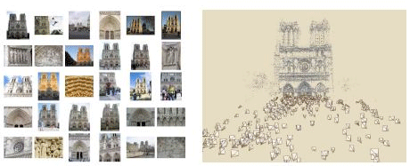
Photo synth
Noah Snavely, Steven M. Seitz, Richard Szeliski, "Photo tourism: Exploring photo collections in 3D," SIGGRAPH 2006
http://photosynth.net/

Slide 21
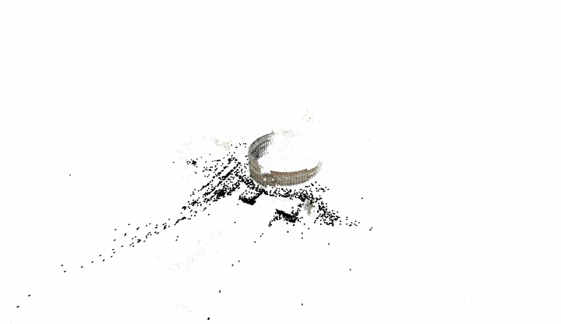
3D from multiple images
Building Rome in a Day: Agarwal et al. 2009

Slide 22
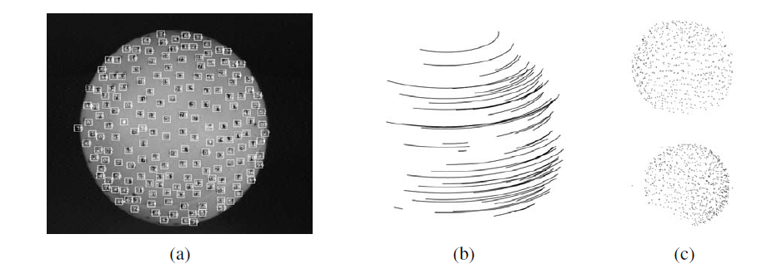
Structure from motion under orthographic projection
3D Reconstruction of a Rotating Ping-Pong Ball
Reasonable choice when
Change in depth of points in scene is much smaller than distance to camera
Cameras do not move towards or away from the scene
C. Tomasi and T. Kanade. Shape and motion from image streams under orthography: A factorization method. IJCV, 9(2):137-154, November 1992.

Slide 23

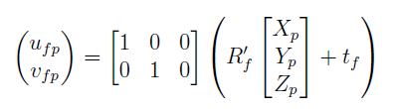
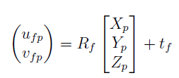

Orthographic projection for rotated/translated camera
x
a₂
a₁
X

Slide 24
Affine structure from motion
Affine projection is a linear mapping + translation in inhomogeneous coordinates
We are given corresponding 2D points (x) in several frames
We want to estimate the 3D points (X) and the affine parameters of each camera (A)
x
a₂
X
Projection of world origin
a₁

Slide 25
Step 1: Simplify by getting rid of t: shift to centroid of points for each camera
2d normalized point
(observed)
3d normalized point
Linear (affine) mapping
Notes:
Makes our world coordinates at the center of the object

Slide 26
Suppose we know 3D points and affine camera parameters …
then, we can compute the observed 2d positions of each point
3D Points (3xn)
Camera Parameters (2mx3)
2D Image Points (2mxn)

Slide 27
Affine structure from motion
Centering: subtract the centroid of the image points
For simplicity, assume that the origin of the world coordinate system is at the centroid of the 3D points
After centering, each normalized point x_{ij} is related to the 3D point X_{i} by
Notes:
Center to get rid of the “b” in “x = AX + b”

Slide 28
Affine structure from motion
Given: m images of n fixed 3D points:
x_{ij} = A_{i} X_{j} + b_{i} , i = 1,… , m, j = 1, … , n
Problem: use the mn correspondences x_{ij} to estimate m projection matrices A_{i} and translation vectors b_{i}, and n points X_{j}
The reconstruction is defined up to an arbitrary affine transformation Q (12 degrees of freedom):
We have 2mn knowns and 8m + 3n unknowns (minus 12 dof for affine ambiguity)
Thus, we must have 2mn >= 8m + 3n – 12
For two views, we need four point correspondences

Slide 29
What if we instead observe corresponding 2d image points?
Can we recover the camera parameters and 3d points?
cameras (2 m)
points (n)
What rank is the matrix of 2D points?
Notes:
The measurement matrix D = MS must have rank 3!

Slide 30
Affine structure from motion
Let’s create a 2m × n data (measurement) matrix:
points (3 × n)
cameras (2 m × 3)
The measurement matrix D = MS must have rank 3!
C. Tomasi and T. Kanade. Shape and motion from image streams under orthography: A factorization method. IJCV, 9(2):137-154, November 1992.

Slide 31
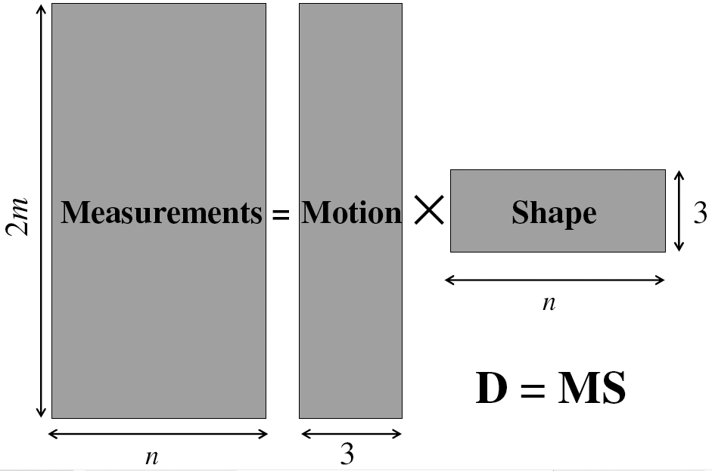
Factorizing the measurement matrix
AX
Source: M. Hebert

Slide 32
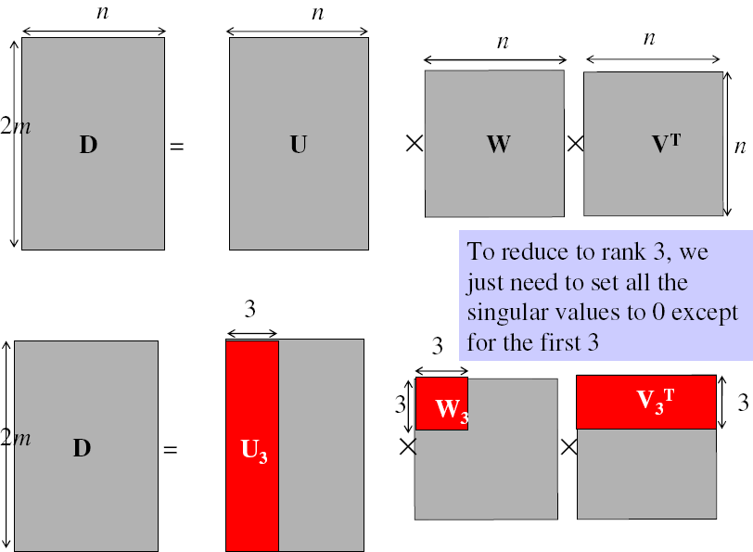
Factorizing the measurement matrix
Singular value decomposition of D:
Source: M. Hebert

Slide 33
Factorizing the measurement matrix
Singular value decomposition of D:
Source: M. Hebert

Slide 34
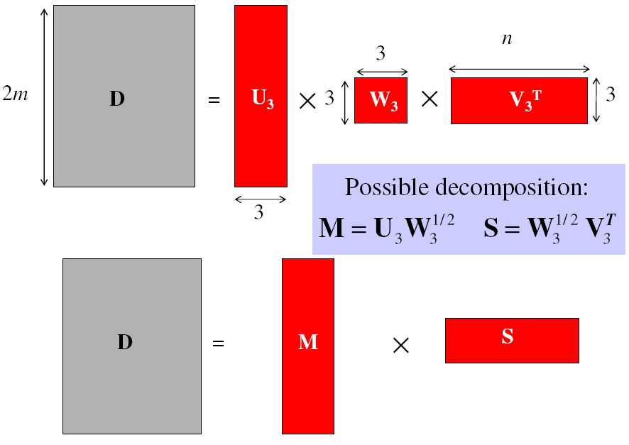
Factorizing the measurement matrix
Obtaining a factorization from SVD:
Source: M. Hebert

Slide 35
Factorizing the measurement matrix
Obtaining a factorization from SVD:
Source: M. Hebert

Slide 36
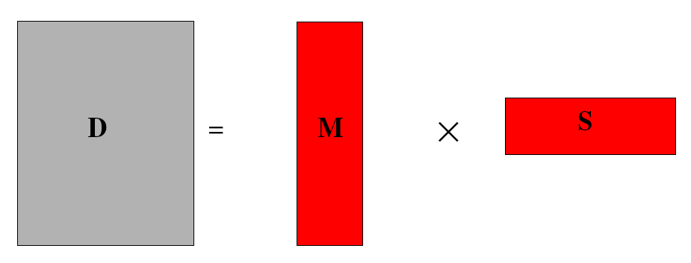
Affine ambiguity
The decomposition is not unique. We get the same D by using any 3×3 matrix C and applying the transformations A → AC, X →C⁻¹X
That is because we have only an affine transformation and we have not enforced any Euclidean constraints (like forcing the image axes to be perpendicular, for example)
Source: M. Hebert

Slide 37
Eliminating the affine ambiguity
Orthographic: image axes are perpendicular and of unit length
a₁ · a₂ = 0
x
|a₁|² = |a₂|² = 1
a₂
a₁
X
Source: M. Hebert

Slide 38
Solve for orthographic constraints
Solve for L = CC^{T}
Recover C from L by Cholesky decomposition: L = CC^{T}
Update A and X: A = AC, X = C⁻¹X
Three equations for each image i
where
~
~

Slide 39
Algorithm summary
Given: m images and n tracked features x_{ij}
For each image i, center the feature coordinates
Construct a 2m × n measurement matrix D:
Column j contains the projection of point j in all views
Row i contains one coordinate of the projections of all the n points in image i
Factorize D:
Compute SVD: D = U W V^{T}
Create U₃ by taking the first 3 columns of U
Create V₃ by taking the first 3 columns of V
Create W₃ by taking the upper left 3 × 3 block of W
Create the motion (affine) and shape (3D) matrices:
A = U₃W₃^{½} and X = W₃^{½} V₃^{T}
Eliminate affine ambiguity
Source: M. Hebert

Slide 40
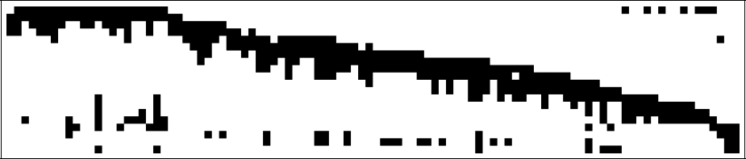
Dealing with missing data
So far, we have assumed that all points are visible in all views
In reality, the measurement matrix typically looks something like this:
One solution:
solve using a dense submatrix of visible points
Iteratively add new cameras
cameras
points

Slide 41
Reconstruction results (your HW 3.4)
C. Tomasi and T. Kanade. Shape and motion from image streams under orthography: A factorization method. IJCV, 9(2):137-154, November 1992.

Slide 42
Further reading
Short explanation of Affine SfM: class notes from Lischinksi and Gruber
http://www.cs.huji.ac.il/~csip/sfm.pdf
Clear explanation of epipolar geometry and projective SfM
http://mi.eng.cam.ac.uk/~cipolla/publications/contributionToEditedBook/2008-SFM-chapters.pdf

Slide 43
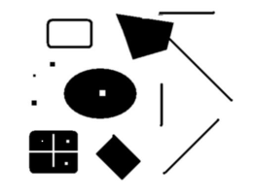
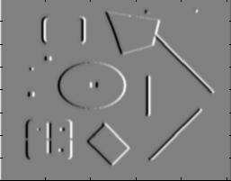
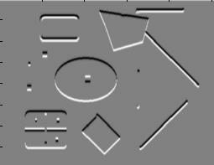
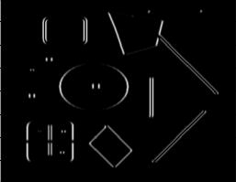
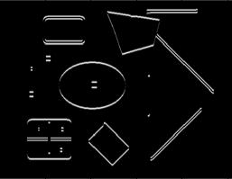
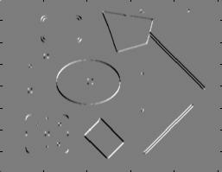
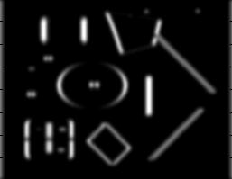
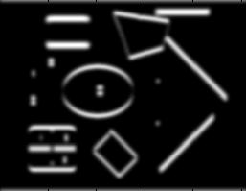
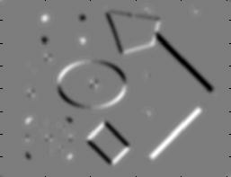
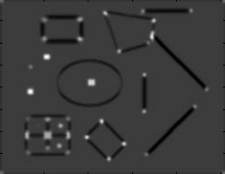
Review of Affine SfM from Interest Points
Detect interest points (e.g., Harris)
I_{x}
I_{y}
1. Image derivatives
I_{x}²
I_{y}²
I_{x}I_{y}
2. Square of derivatives
3. Gaussian filter g(σ_{I})
g(I_{x}²)
g(I_{y}²)
g(I_{x}I_{y})
4. Cornerness function – both eigenvalues are strong
5. Non-maxima suppression
har

Slide 44
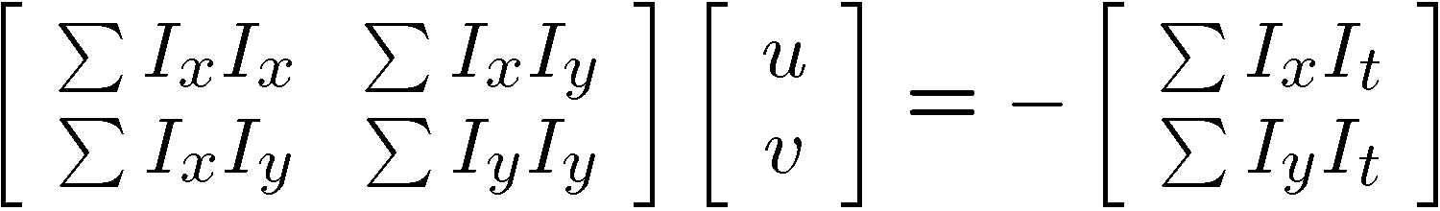
Review of Affine SfM from Interest Points
2. Correspondence via Lucas-Kanade tracking
Original (x,y) position
Initialize (x’,y’) = (x,y)
Compute (u,v) by
Shift window by (u, v): x’=x’+u; y’=y’+v;
Recalculate I_{t}
Repeat steps 2-4 until small change
Use interpolation for subpixel values
I_{t} = I(x’, y’, t+1) - I(x, y, t)
2nd moment matrix for feature patch in first image
displacement

Slide 45
Review of Affine SfM from Interest Points
3. Get Affine camera matrix and 3D points using Tomasi-Kanade factorization
Solve for orthographic constraints

Slide 46
HW 3: Problem 4 summary
Tips
Helpful matlab functions: interp2, meshgrid, ordfilt2 (for getting local maximum), svd, chol
When selecting interest points, must choose appropriate threshold on Harris criteria or the smaller eigenvalue, or choose top N points
Vectorize to make tracking fast (interp2 will be the bottleneck)
If you get stuck on one part, can use the included intermediate results
Get tracking working on one point for a few frames before trying to get it working for all points
Extra optional problems
Affine verification
Missing track completion
Optical flow
Coarse-to-fine tracking

Slide 47
Tips for HW 3
Problem 1: vanishing points
Use lots of lines to estimate vanishing points
For estimation of VP from lots of lines, see single-view geometry chapter, or use robust estimator of a central intersection point
For obtaining intrinsic camera matrix, numerical solver (e.g., fsolve in matlab) may be helpful
Problem 3: epipolar geometry
Use reprojection distance for inlier check (make sure to compute line to point distance correctly)
Problem 4: structure from motion
Use Matlab’s chol and svd
If you weren’t able to get tracking to work from HW2 can use provided points

Slide 48
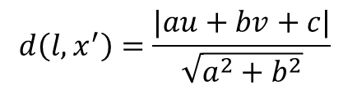
Distance of point to epipolar line
l=Fx=[a b c]
.
x
.
x‘=[u v 1]
$$d\left(l,x^{′}\right)=\frac{|au+bv+c|}{\sqrt{a^{2}+b^{2}}}$$

Slide 49
Next class
Clustering and using clustered interest points for matching images in a large database

